Slide 1
Motivation

Slide 2
Learning Outcome
After doing this Unit the students would be able to
Apply the following theories of Motivation for enhancing performance in organizational settings :
Early Theories :
  Maslow’s Hierarchy of Needs Theory
  Herzberg’s Two Factor Theory
  Alderfer’s ERG Theory
Contemporary Theories
  Mc Clelland’s Achievement-Motivation Theory
  Expectancy Theory
  Goal Setting Theory
  Equity Theory

Slide 3
Introduction to Context
Have you ever thought of why people of average intelligence outperform people with the higher level of intelligence ?

Slide 4
Test your Understanding!!
Ian, a manager in mid size speciality consumer products company places a high premium on always being right but is unaware of his need and how it makes him arrogant, defensive, cautious in turn.
When a project falters or a client is unhappy, Ian in unable to work with his direct reports, his boss and co workers to reach a common understanding of problem. He focuses on blaming one or the other.

Slide 5
Terminology
Motivation is the intensity, direction and persistence of efforts towards achievement of organizational goals.
Extrinsic factors : not within the control of the individual e.g salary, promotion, incentive, award
Intrinsic factors : within the control of the individual e.g passion, commitment, interest in work, identification with work

Slide 6
Factors of Motivation that affect performance of employees
Rewards | Leadership | Empowerment | Trust

Slide 7
EARLY THEORIES
1. Hierarchy of Needs Theory: Abraham Maslow
2. Herzberg’s two factor theory/ Motivation-Hygiene Theory
3. Alderfer’s ERG theory

Slide 8
1. Hierarchy of Needs Theory : Abraham Maslow

Slide 9
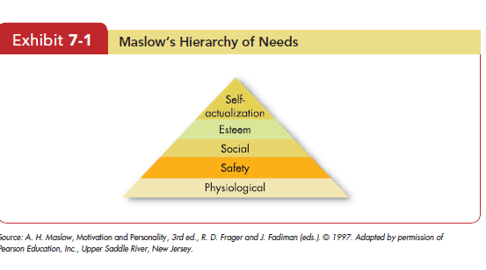

Slide 10
2. Herzberg’s 2 factor Theory
or
Motivation- Hygiene Theory

Slide 11
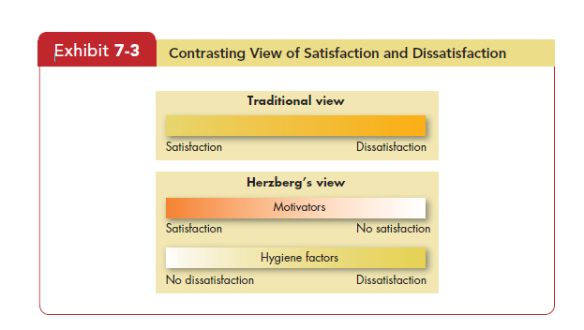

Slide 12
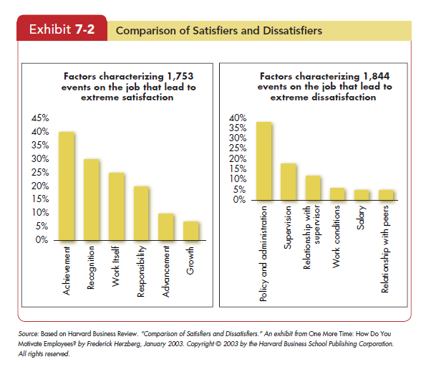

Slide 13
3. Alderfer’s ERG Theory of Motivation

Slide 14
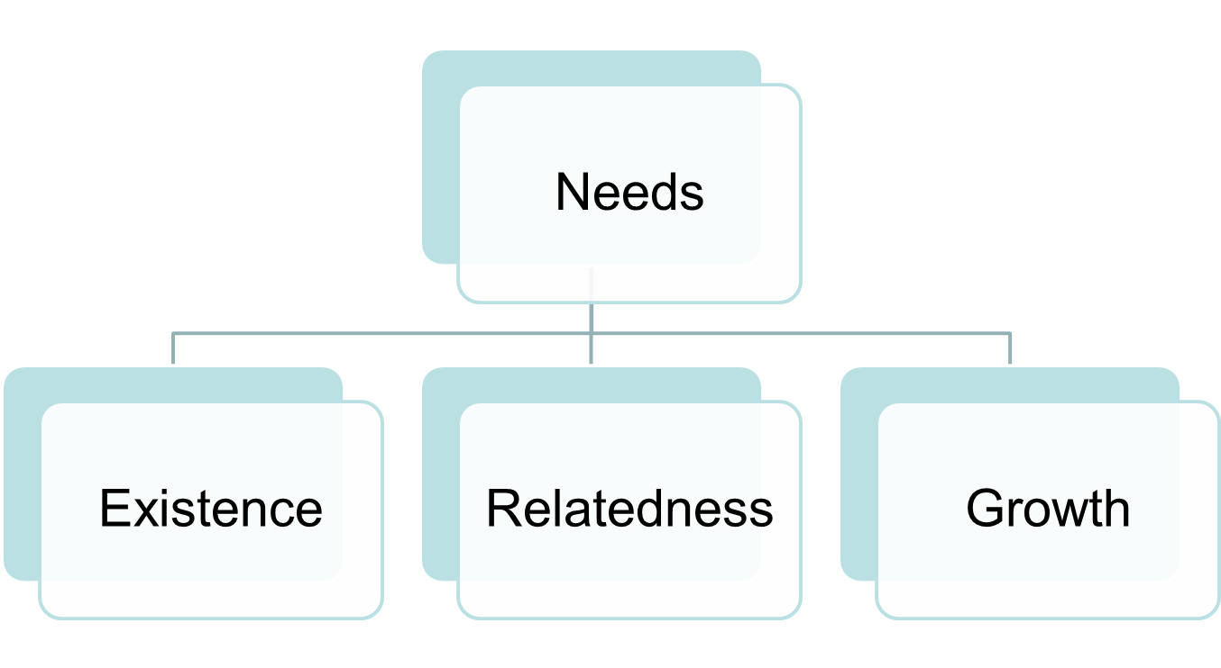
Alderfer’s ERG Theory of Motivation

Slide 15
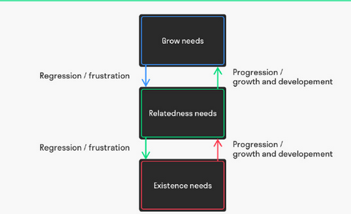
Alderfer’s ERG Theory of Motivation

Slide 16
CONTEMPORARY THEORIES
4. McClelland’s Theory
5. Goal Setting Theory by Edwin Locke
6. Expectancy Theory by Victor H. Vroom
7. Equity Theory by J.Stacy Adams

Slide 17
4. Mc.Clelland’s Theory of Achievement-Motivation
Or
Mc.Clelland’s 3 Needs Theory

Slide 18
McClelland’s theory of needs
David McClelland and his associates.
● Need for achievement (nAch) is the drive to excel, to achieve in relation to a set of standards.
● Need for power (nPow) is the need to make others behave in a way they would not have otherwise.
● Need for affiliation (nAff) is the desire for friendly and close interpersonal relations

Slide 19
Mc Clelland High Achievers
High Achievers prefer jobs with:
Personal responsibility
Feedback
Intermediate degree of risk

Slide 20
Revision
Q1: Who proposed the hierarchy of needs theory of motivation?
Abraham Maslow
David McClelland
Victor Vroom
Frederick Herzberg

Slide 21
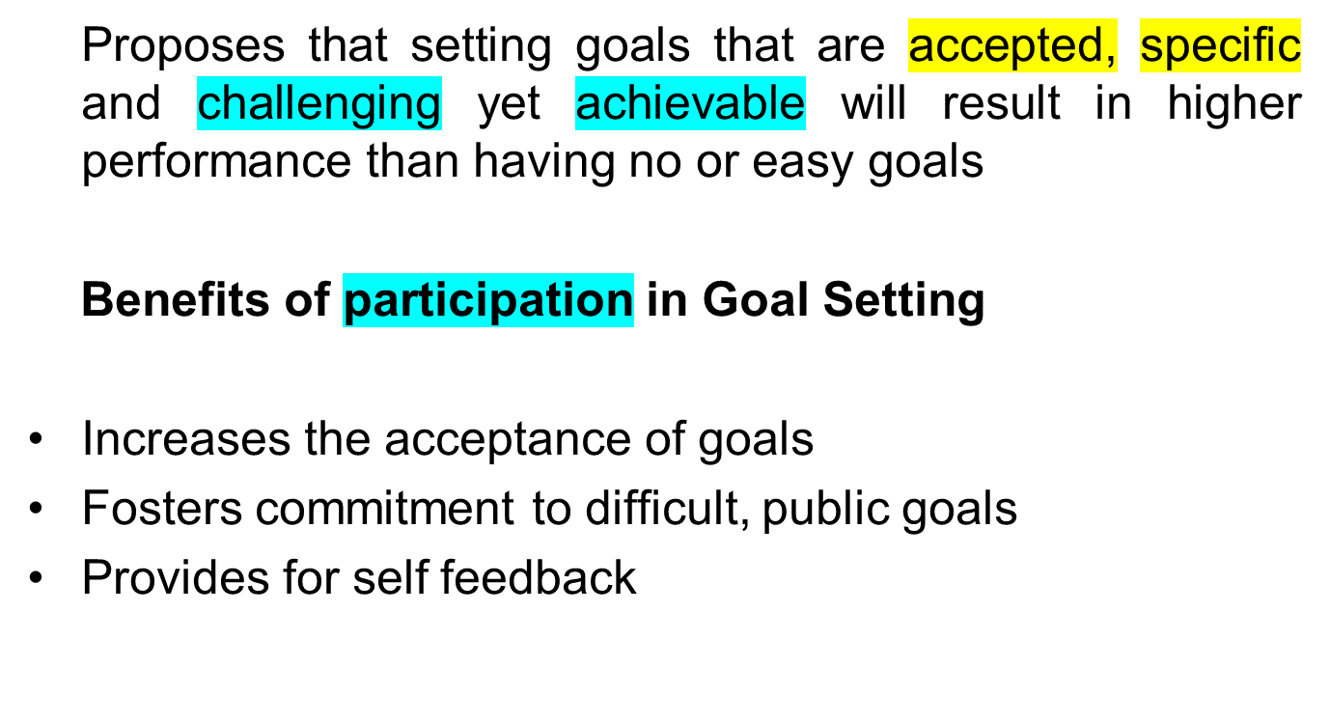
5. Goal Setting Theory

Slide 22
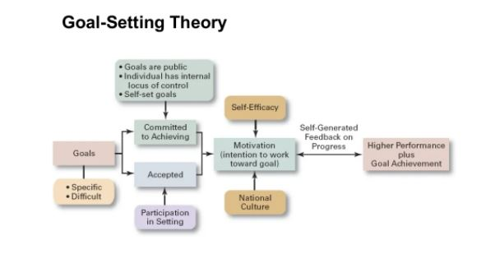

Slide 23
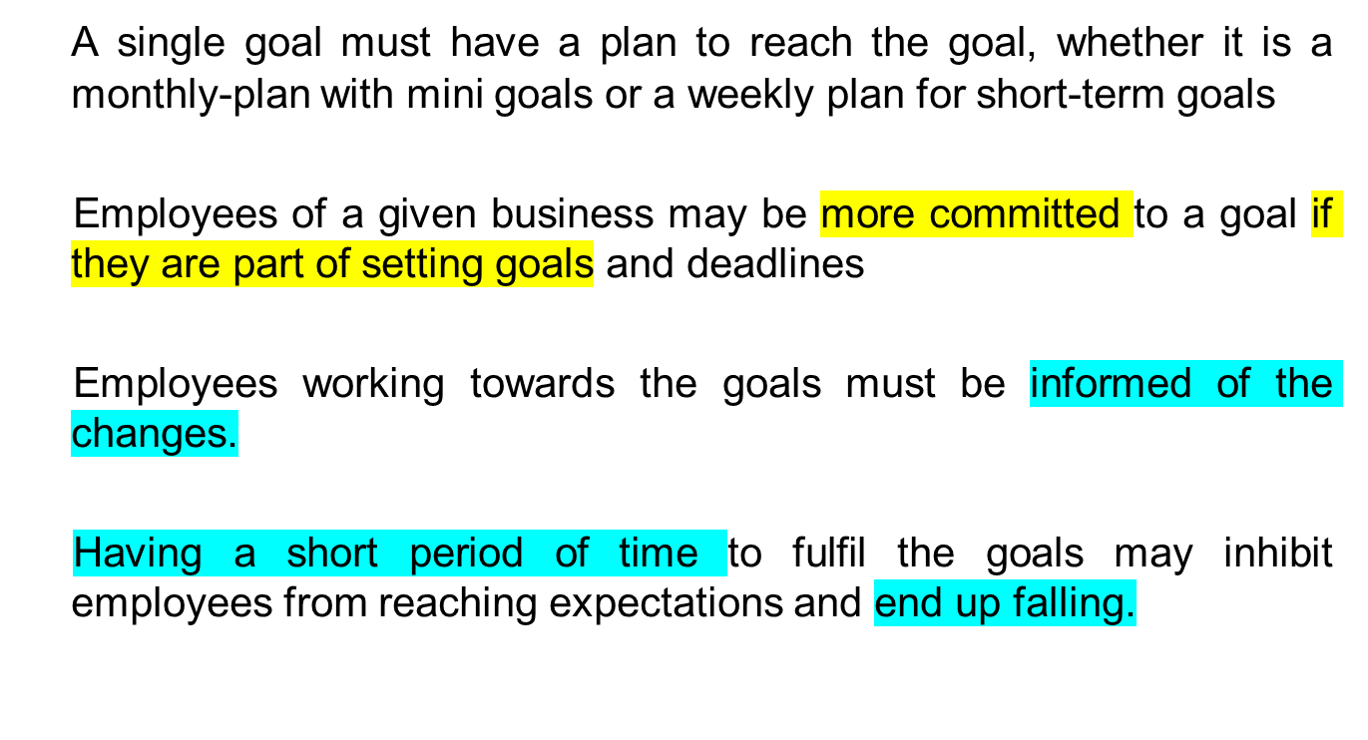
Business Goal-Setting

Slide 24
6. Equity Theory
Proposes that employees perceive what they get from a job situation (outcomes) in relation to what they put in (inputs) and then compare their inputs-outcomes ratio with the inputs-outcomes ratios of relevant others
Referent comparisons that an employee can use:
Self-inside: An employee’s experiences in a different position inside his or her organization.
Self-outside: An employee’s experiences in a situation or position outside his or her current organization
Other-inside: Another individual or group of individuals inside the employee’s organization.
Other-outside: Another individual or group of individuals outside the employee’s organization.

Slide 25
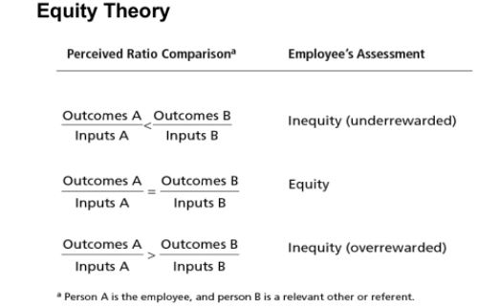

Slide 26
Application
Effective performance management system enable a small-business manager:
Clarify job responsibilities and expectations
Develop employee capabilities
Aligns employee behaviour to the company’s strategic goals

Slide 27
7. Expectancy Theory
Determinants of motivation are :
Expectancy: The belief that one’s efforts will positively influence one’s performance.
Instrumentality: An individual’s beliefs regarding the likelihood of being rewarded in accordance with his or her own level of performance.
Valence: The value a person places on the rewards he or she expects to receive from an organization.
Performance= f(Ability*Motivation*Opportunity)

Slide 28
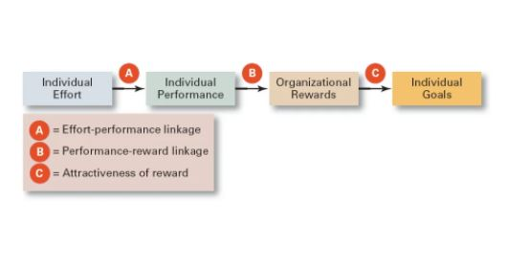

Slide 29
Application
Expectancy theory operates on the premise that employees base an individual level of effort on what is necessary to perform well and earn rewards within the workplace
Recruiters who construct in-house job postings do so in a manner that generates interest in the current workforce.
Interviewers develop a line of questions to determine how potential candidates will react to certain workplace conditions which makes hiring decisions well-informed one.

Slide 30
Relationship between Job Engagement and Motivation
When nurse Melissa Jones comes to work, it seems that everything else in her life goes away, and she becomes completely absorbed in what she is doing.
Her emotions, her thoughts, and her behavior are all directed toward patient care. She can get so caught up in her work that she isn’t even aware of how long she’s been there.
As a result of this total commitment, she is more effective in providing patient care and feels uplifted by her time at work.

Slide 31
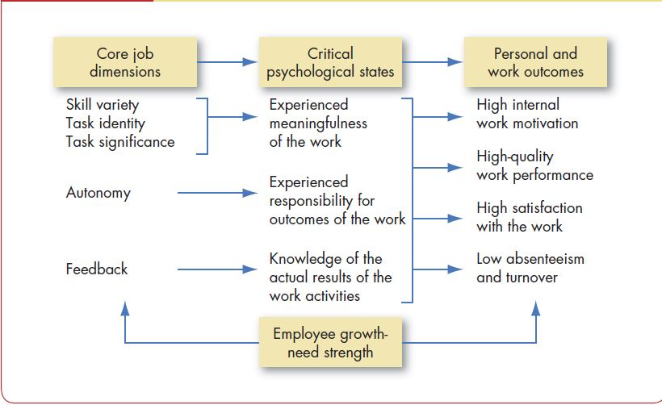
Job Characteristics Model

